Slide 1
Shiny packages
An introduction to making an interactive web application

Slide 2
Introduction
What is R shiny ?
How dose it works ?
Do I need to know how to code in HTML
Features
Motive for using Shiny packages
Ui and server

Slide 3
introduction
Shiny is an R package that makes it easy to build interactive web apps straight from R.
It helps to host standalone apps on a webpage or embed them in R Markdown documents or build dashboards.
To use a package in R programming one must have to install the package first. This task can be done using the command
install.packages(“packagename”).

Slide 4
Features
No compulsion of JavaScript
Attractive default UI theme based on Twitter Bootstrap.
A highly customizable slider widget with built-in support for animation.
Pre-built output widgets for displaying plots, tables, and printed output of R objects.
Build useful web applications with only a few lines of code—no JavaScript required.

Slide 5
Getting started
> install.packages(“shiny”)
> library(shiny)
> runApp(“my_app”)
Every shiny app has two R scripts :
shinyUI(fluidPage())
shinyServer(function(input, output) {} )

Slide 6
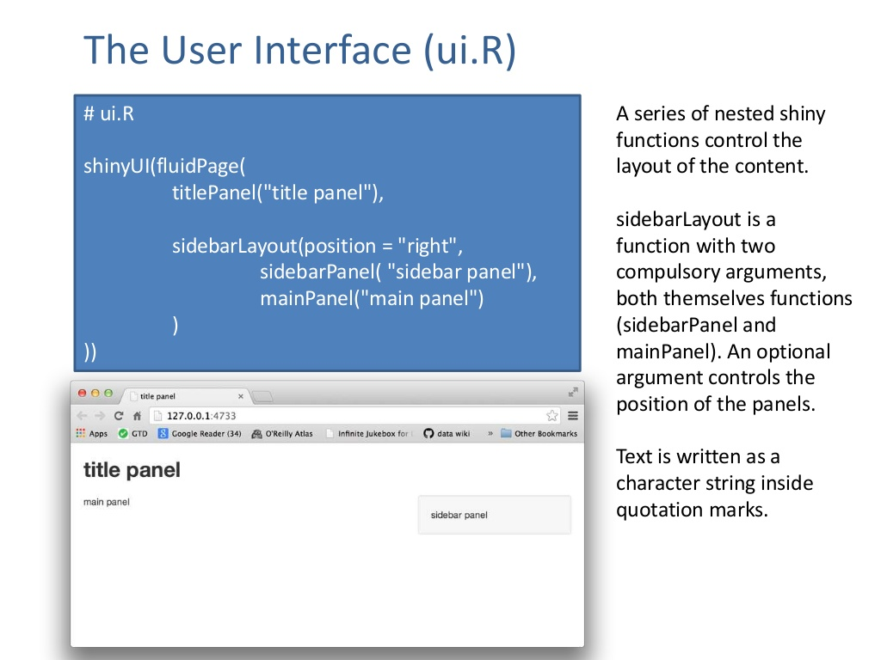
The user interface (ui.R)

Slide 7
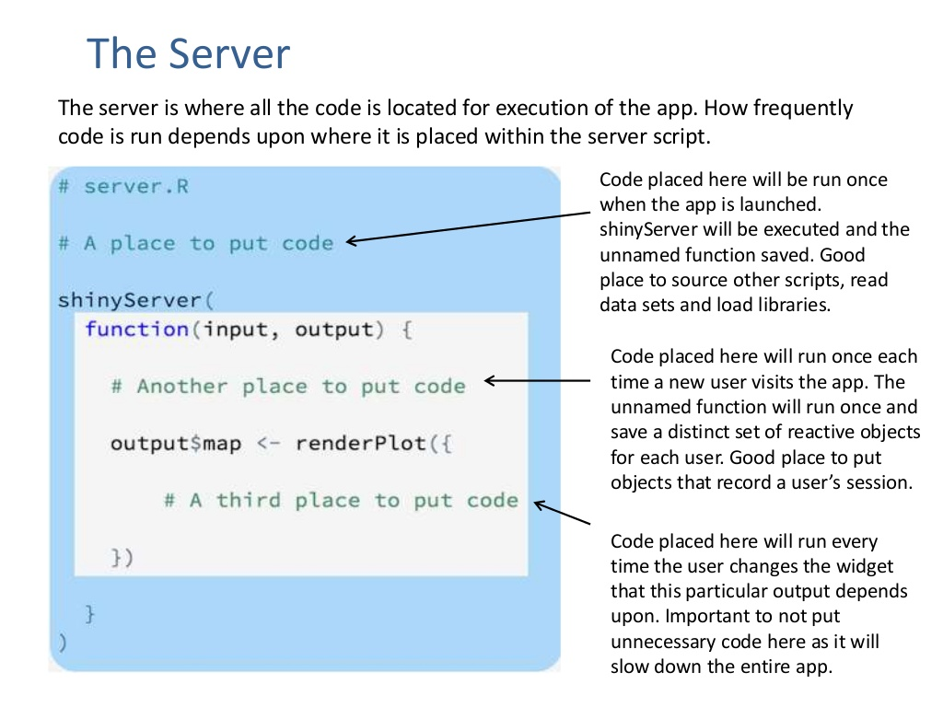
The server
The server is where all the code is located for execution of the app. How frequently code is run depends upon where it is placed within the server script.

Slide 8
More complex shiny functions
Reactive Expressions
Absolute Positioning
Interactive Visualisation
Progress Bars
Integrtion with R Markdown
Shiny Server Pro

Slide 9
Sharing apps
There are basically two main options:
Share the file with users that have R and know how to use it.
Share it as a web page.
Host an app yourself
Shinyapps.io
Shiny Server

